Slide 1
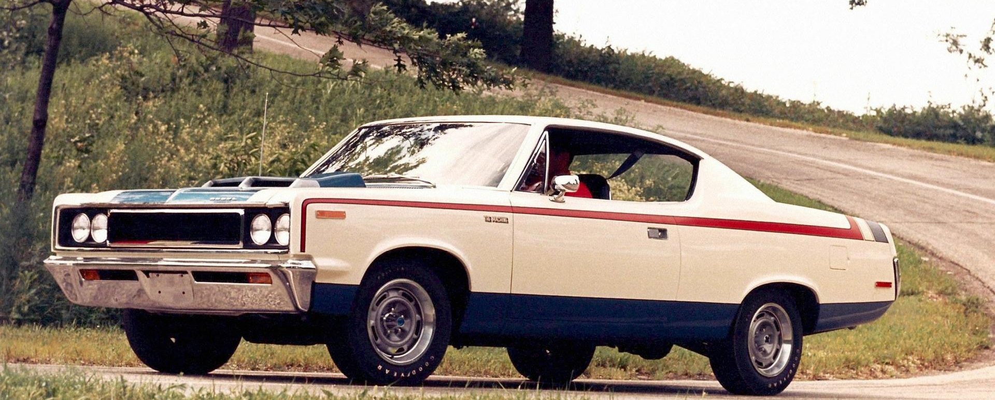
Car Evaluation Classification
Filip Nový
University of Southern Denmark
DSK804 May 2025

Slide 2
Dataset Introduction
Originally created to demonstrate decision-making in expert systems.
Derived from a hierarchical model that evaluates cars based on price and technical characteristics.
Source: UCI Machine Learning Repository Created by Marko Bohanec & Blaz Zupan (1997)
Final version includes 1,728 instances with 6 input attributes and 1 target class.

Slide 3
Attributes (All categorical)
Purchase Price
Maintenance Cost
Number of Doors
Passenger Capacity
Trunk Size
Safety Rating

Slide 4
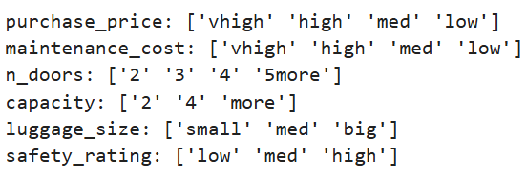
Dataset Features
All inputs are qualitative, no missing values
Dataset is fully preprocessed — no cleaning required

Slide 5
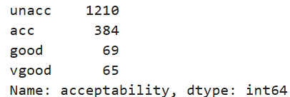
Target Variable: Acceptability
Unacceptable
Acceptable
Good
Very good

Slide 6
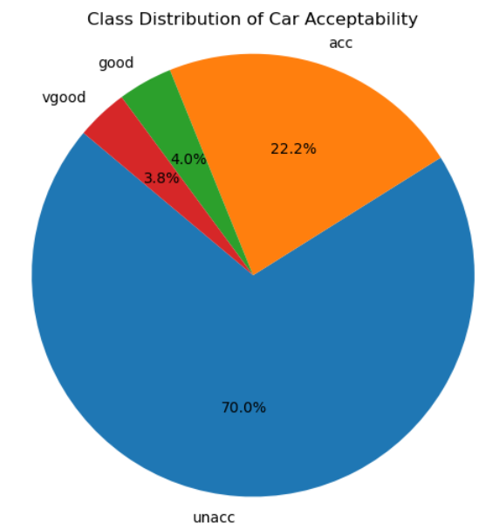
Evaluation strategy
Accuracy – biased
Precision – proportion of correct positive predictions
Recall – ability to find all relevant instances
F1-score – harmonic mean of precision & recall

Slide 7
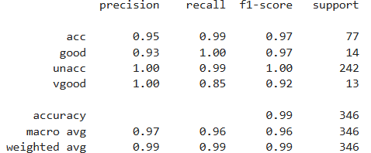
Decision TRee
near-perfect results
minority classes handled well (vgood‘s recall not as good)
possible overfitting

Slide 8
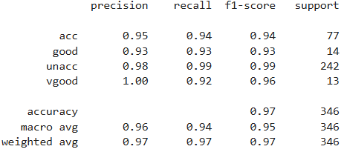
Random forest
performance consistent across all classes
better recall on vgood
accuracy worse
less prone to overfitting

Slide 9
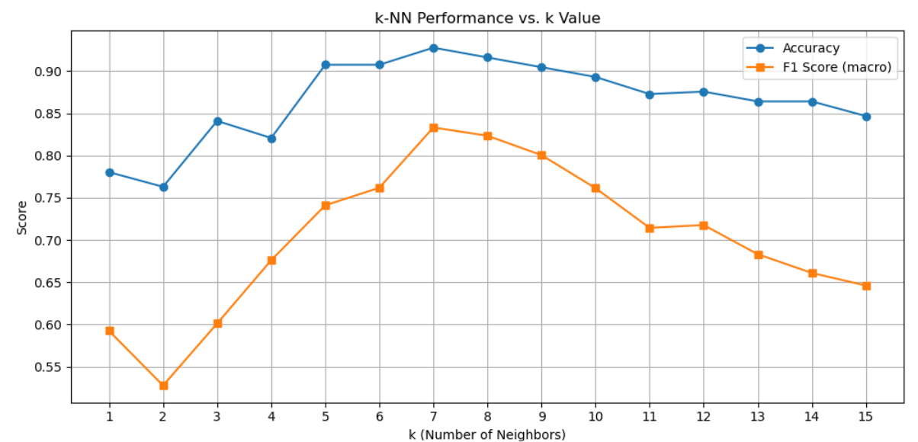
k-nearest neighbors

Slide 10
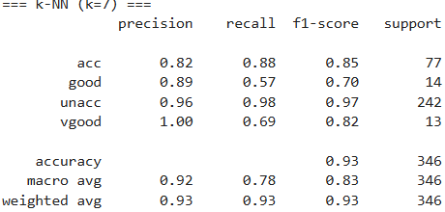
k-nearest neighbors
93% accuracy
high F1 score on unacc, acc
weak recall on good, vgood
performed surprisingly well with ordinal-encoded categorical data

Slide 11
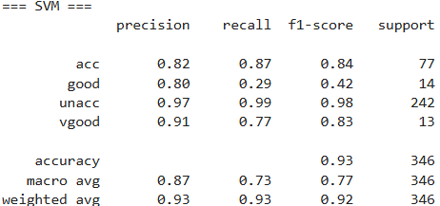
support vector machine
93 % accuracy
great at predicting unacc
terrible recall for good
Struggles with ordinal-encoded categorical data

Slide 12
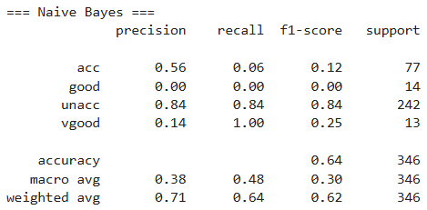




naïve bayes
terrible performance
perfect recall, low precision => classified as vgood too often

Slide 13
results
Decision tree had the best results, but it might be overfitting
=> random forest was the best overall

